Slide 1
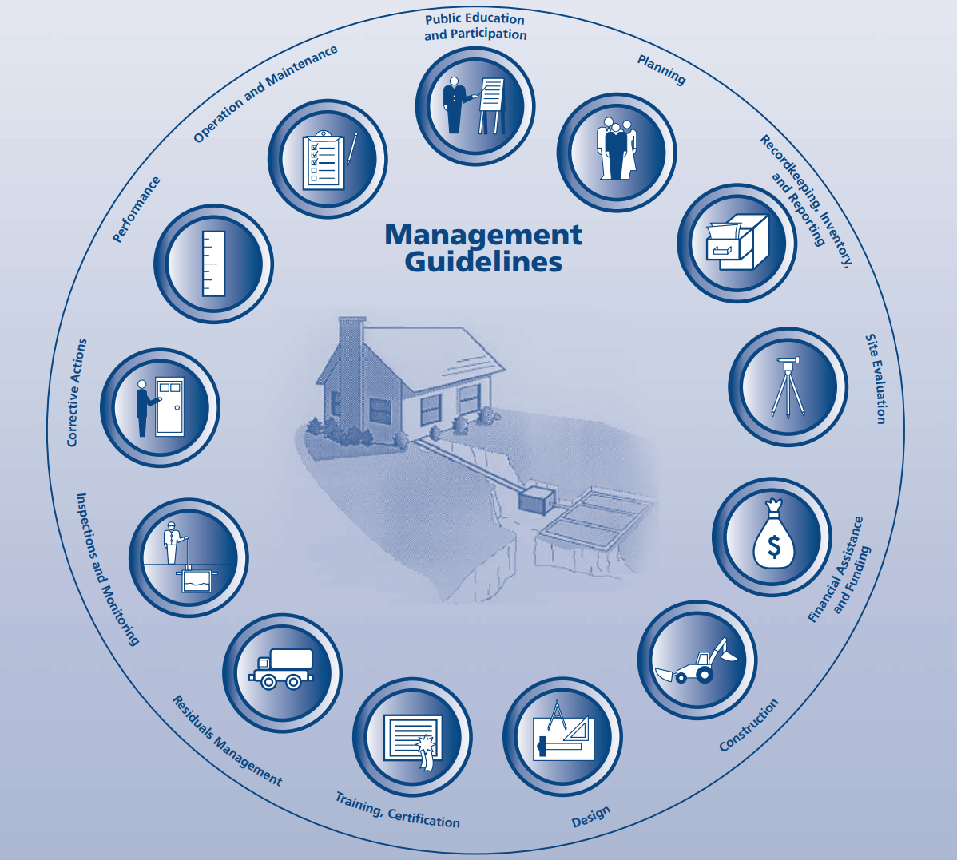
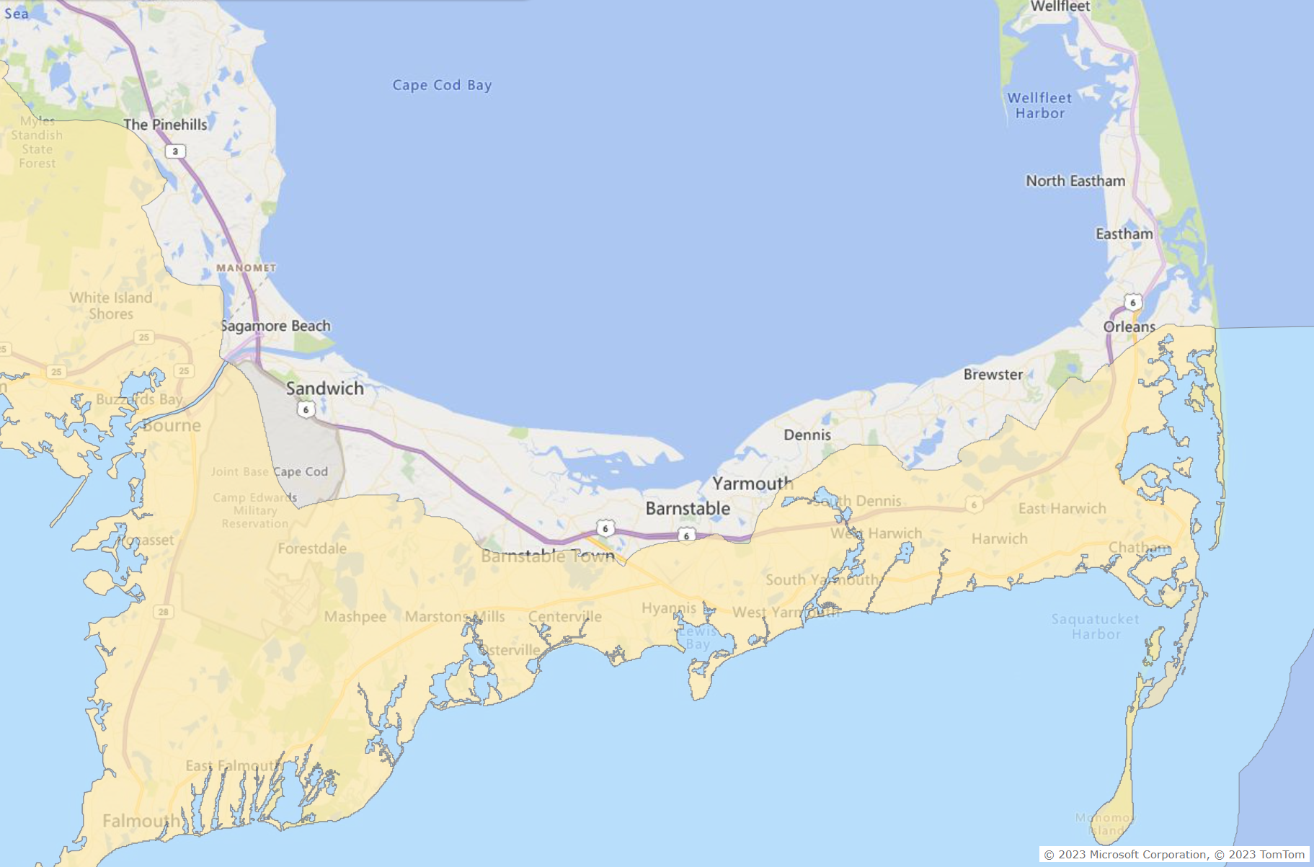
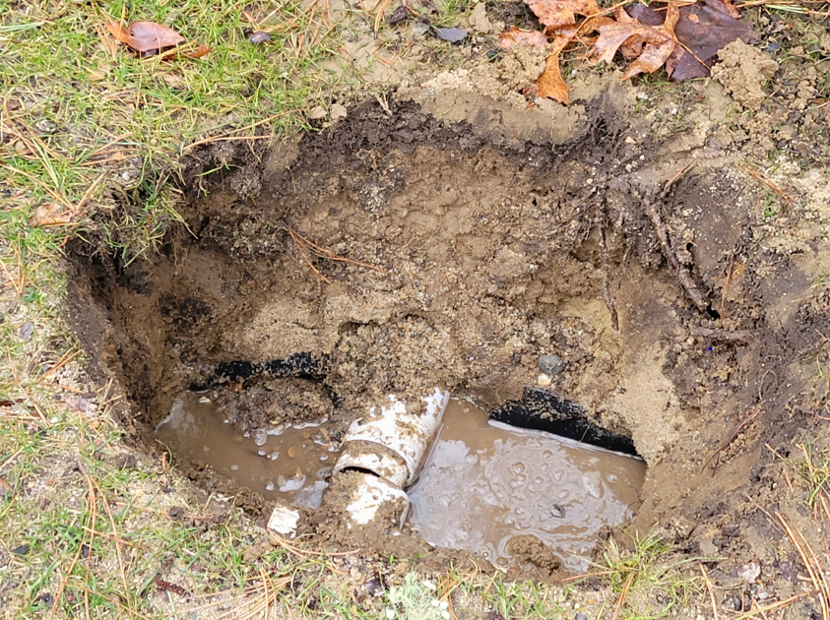
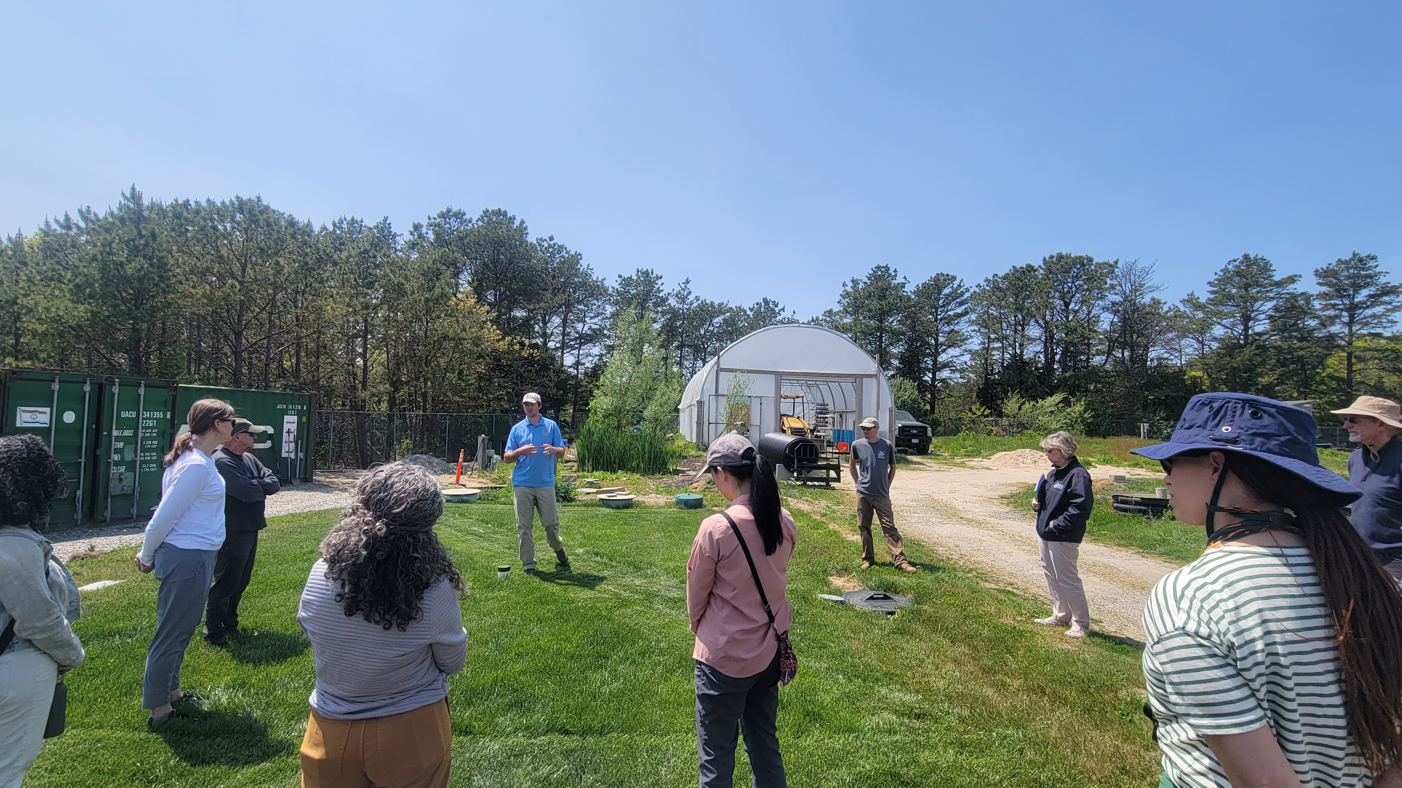
Management tools for water quality protection:
A Responsible Management Entity for on-site Innovative/Alternative septic systems
Alexie N. Rudman¹ & Brian Baumgaertel¹
1 Massachusetts Alternative Septic System Technology Center (MASSTC), Barnstable County Department of Health and Environment, Barnstable, MA
What is an RME?
The Key Considerations of an RME
A Holistic Management Approach
A Responsible Management Entity (RME) provides wastewater management support for residential Innovative/Alternative (I/A) septic systems meant to protect our health and environment. It oversees every aspect of the I/A system life cycle, much like a sewer utility oversees all aspects of municipal treatment, to ensure these systems are dependably restoring our watersheds.
Our Vision: Help Barnstable County communities meet their water quality and public health goals by supporting Enhanced Innovative/Alternative septic systems for better performance and reliability through the establishment of a flexible and equitable management utility.
Technology
Management
Public Outreach
The RME will care for all 13 aspects of an I/A system’s life-cycle, from design and installation through long-term monitoring and maintenance, in a flexible way designed to meet each municipality’s unique needs and context.
The RME will convene a Recommended Technologies Panel (RTP) to help determine criteria for I/A system inclusion into the program. The RTP will help qualify data on system performance for analysis and review performance data.
The RME will develop the management infrastructure to care for I/A systems, and will contract with engineers, installers, and service providers to install and maintain I/A systems in pilot towns.
The RME will regularly engage with homeowners and decision-makers to assess informational needs and develop the program around them. Ensuring information is accessible to different audiences is critical.
0
0
0
Outcomes
An error made during installation led to system malfunction and required repair.
The RME keeps stakeholders informed on I/A systems and the importance of management.
A paradigm shift in wastewater management: decentralized wastewater systems are infrastructure and should be treated as such
Reliable nitrogen-removal performance from I/A septic systems
Confidence in the ability of decentralized technology to meet environmental and public health goals
A transferrable model illustrating processes for establishing the RME as well as lessons learned, to be adapted by other municipalities with a need to manage decentralized infrastructure for nutrient reduction
Why do we need an RME?
I/A system management as it stands is inconsistent. These perform better with regular operation and maintenance (O&M), which will ensure health and environmental goals are met.
Homeowners are currently responsible for I/A system installation and O&M. This process is exceptionally complicated and confusing but would be absorbed by the RME.
Municipalities have limited capacity to ensure I/A systems comply with regulations.
An RME will help implement and monitor wider I/A system adoption. 90% of Cape Cod homes depend on decentralized wastewater treatment, the lead cause of pollution in Cape Cod’s estuaries. To address this, municipalities plan to deploy I/A technology at a wider scale.
Simple errors during design and installation can lead to systems’ underperformance. An RME can mitigate errors by developing of trainings and standards for industry personnel.
6. To collect and distribute independent data to support environmental decision-making. This is achieved through third-party sampling and reporting.
Participant towns in the RME Pilot include Bourne, Falmouth, Brewster, Shubael Pond in Barnstable, and Wellfleet, MA. The yellow area denotes the SNEP region. Funding from The Nature Conservancy allows us to work in non-SNEP areas.
Who Does the RME Serve?
Homeowners: Reduces risk and responsibility by absorbing homeowner obligations and providing system support through a yearly utility fee
Municipalities: Helps towns comply with environmental goals through system maintenance, monitoring, technical support
Regulatory Agencies: Provides independent, rigorous data on system performance to support decision-making
The RME Pilot is graciously funded and supported by SNEP, TNC, and Barnstable County
Questions? Interested in a tour? Please contact Brian & Alexie
bbaumgaertel@capecod.gov; alexie.rudman@capecod.gov
Notes:
-Ask Kate if map is properly cited and if I shouldn’t cite the PFW report instead
-Partnering with local organization is important: they are there all the time to be the continuous face of the effort. EPA is kind of obscure to most people, they don’t ask us things directly, it is outside of our capacity to communicate about day-to-day events

