Slide 1
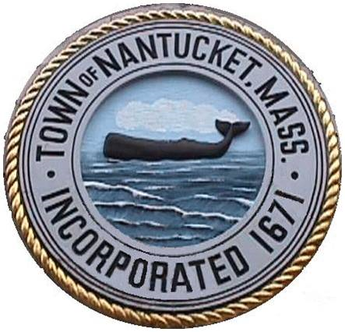
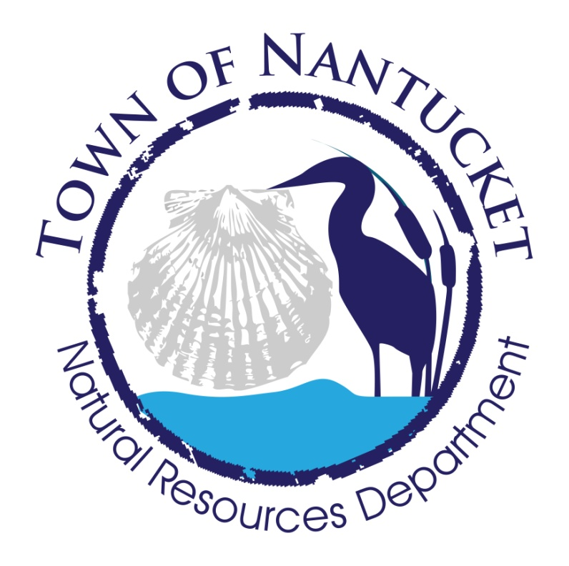
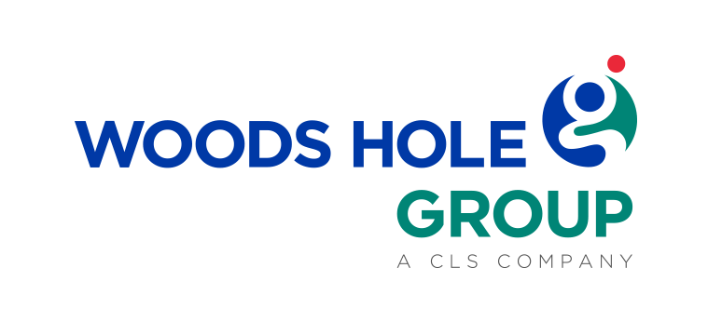
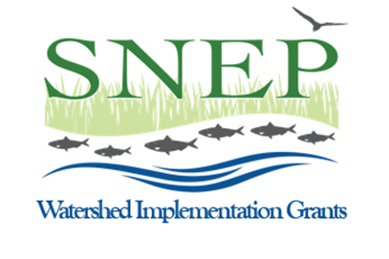
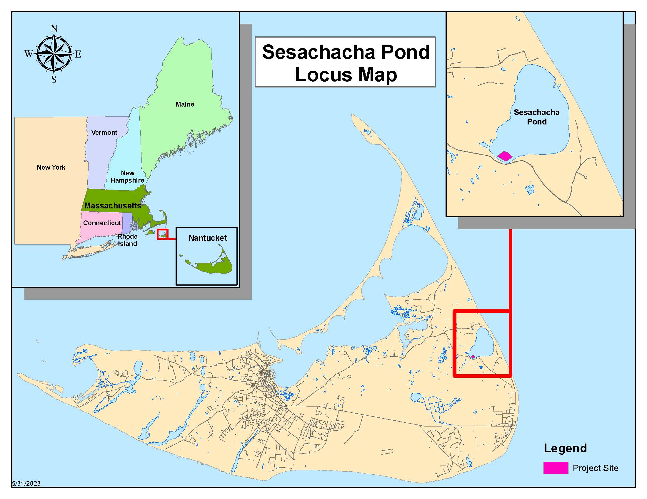
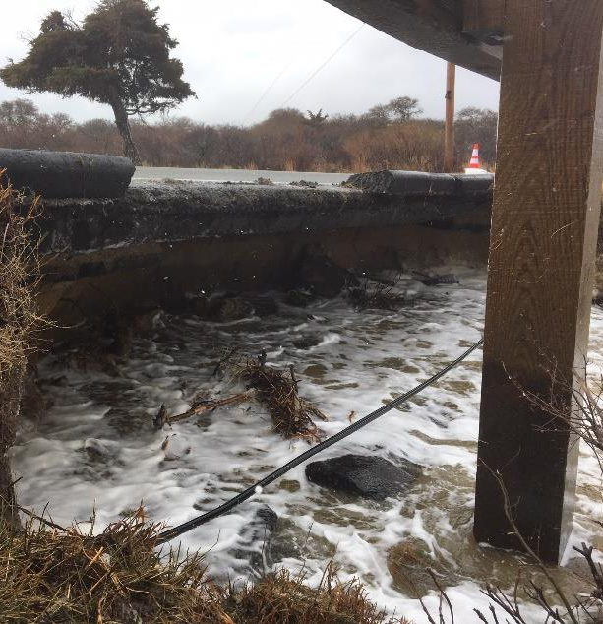
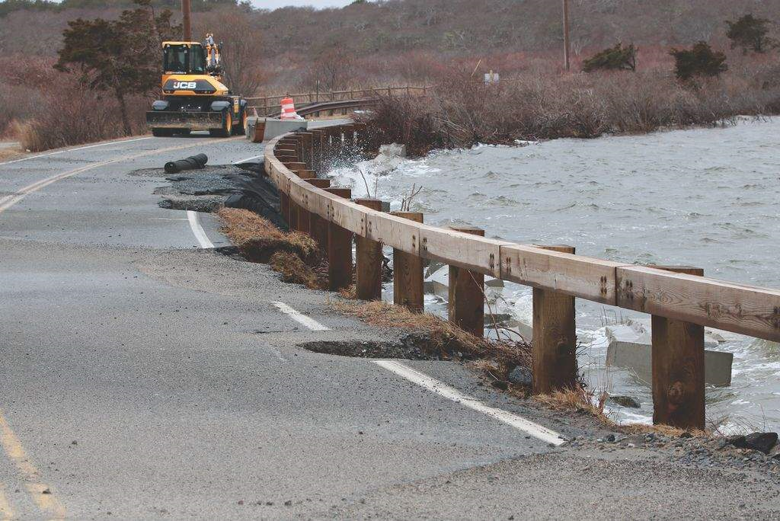
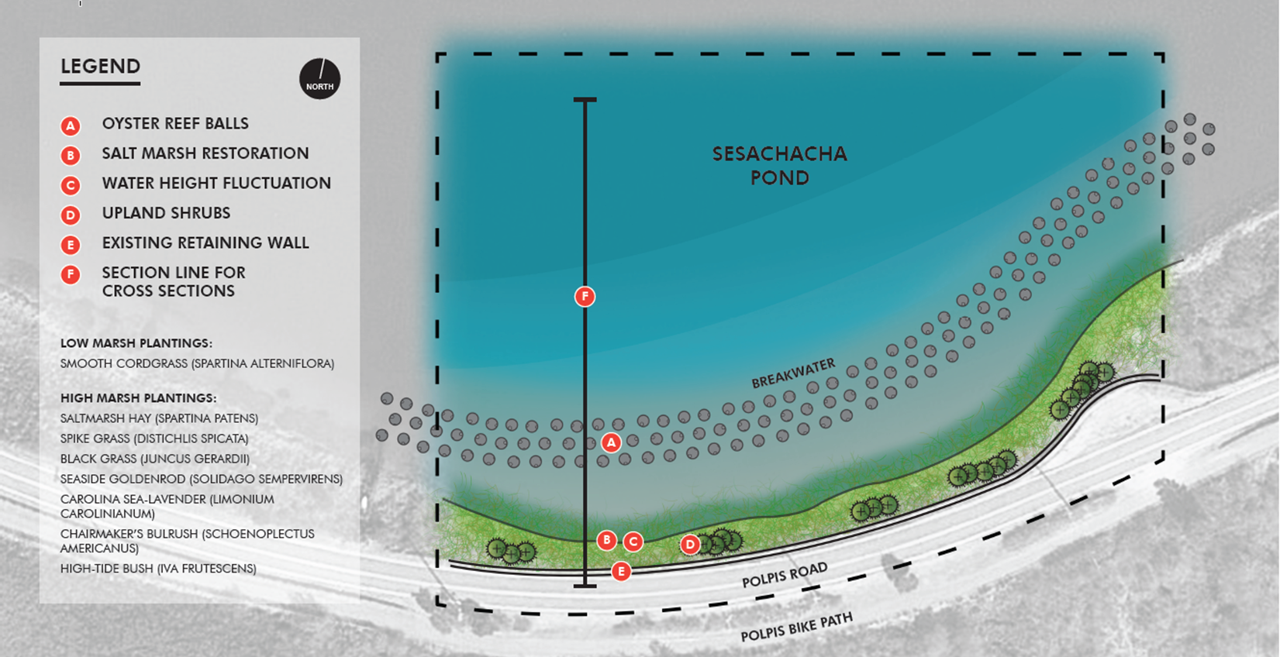
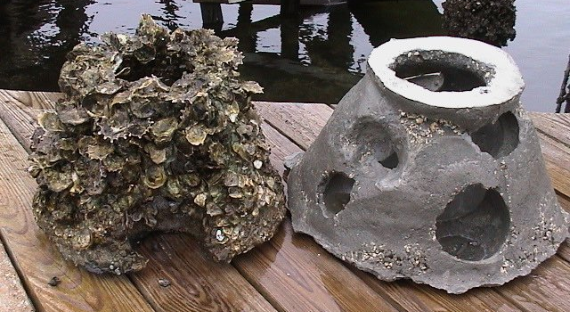
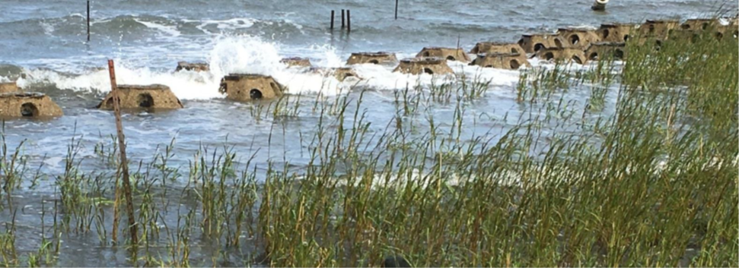
Sesachacha Pond Ecological Enhancement and Resilience Strategies on Nantucket, MA
Leah Hill
Coastal Resilience Coordinator
Town of Nantucket Natural Resources Department
Lhill@nantucket-ma.gov 508-228-7200 ext. 7603
INTRODUCTION
PROJECT GOALS
The Island of Nantucket is located ~30 miles off of Cape Cod in the Atlantic Ocean (Figure 1.)
The Island experiences high wind, wave energy, flooding and erosion which will be exacerbated by climate change and sea level rise
This project is focused in one of Nantucket’s brackish great ponds, Sesachacha (Figure 1.). This pond is facing water quality degradation due to increased nutrient loading. The decline in water quality has led to a reduction in habitat for benthic species including the pond’s natural population of oysters.
In 2018 a winter storm event led to severe episodic erosion that caused Polpis Road, the roadway that runs along the southwest side of the Pond, to fail (Figure 2.). As a result, the road was unpassable for several weeks.
To protect Polpis Road using the best environmentally friendly solution while providing adequate protection to maintain the integrity of the roadway.
Address the problem of wind and water driven erosion occurring at the interface of Sesachacha Pond and Polpis Road by attenuating wave energy with a constructed oyster reef.
Increase the natural oyster population within Sesachacha Pond by providing suitable habitat (i.e., reef balls).
Improve water quality within the eutrophic pond and increase biodiversity in the pond and surrounding coastal habitats.
Serve as an educational experience for locals and visitors to learn about adaptable nature-based solutions to help mitigate hazards from climate change.
Serve as a transferable model around New England for an adaptable, nature-based solution to address problems exacerbated by climate change.
Figure 1. Locus map of Nantucket, MA showing the project site in Sesachacha Pond.
January ’23
February ’23
March ’23
April ’23
Town hired Woods Hole Group to help facilitate project
Signed grant agreement
Project kick-off meeting
Standard Operating Procedures (SOPs) draft developed
SOPs approved
QAPP draft developed
Gathered historic wind and water level data
August-December ’23
July ’23
June ’23
May ’23
Geotechnical subsurface investigation
90% Engineered reef plans
Hold public hearing
Start local, state, and federal permitting
Prepare nearshore reef alternatives
Assess and choose nearshore reef alternative
Model wave conditions
Prepare existing conditions plan
QAPP sent for review
Bathymetric and topographic surveys completed
Wetland delineation completed
Sediment sampling completed
Figure 2. Polpis Road failure from a winter storm in 2018.
PROJECT DESCRIPTION
PHASE 1 (SNEP FUNDED):
Conduct topographic survey, bathymetric survey, wetland delineation, and sediment sampling and analysis.
Design, permit, and install a nearshore oyster reef using reef balls and oyster shell bags to protect the shoreline along Polpis Road (Figure 3.). The reef will attenuate waves, reduce erosion, increase sedimentation on the landward side, while enhancing oyster habitat.
Outreach efforts through tours, presentations, local forums, signage, and project website.
PHASE 2 (FUNDING NEEDED):
Work off phase 1
Design, permit, and install a living shoreline between Polpis Road and Sesachacha Pond to permanently stabilize the shoreline while enhancing habitat with
natural vegetation (Figure 3.).
January-March ’24
April-August ’24
September-December ’24
WHAT ARE REEF BALLS?
Complete permitting
Design project website
Order reef balls
Develop implementation plan
Develop project lesson plans for students
Develop project sign
Deploy reef
Conduct outreach tours
Implement project lesson plan
Conduct field trips with school students to site
SNEP grant complete
Created by Reef Innovations and used world-wide to create habitat for many species including fish, corals, and oysters (Figure 4.)
Secondary benefits include living breakwater, promote sediment accretion on the landward side, and promote marsh growth (Figure 5.)
Made from marine friendly concrete with micro silica and crushed oyster shell that has a similar pH to sea water
Designed to create miniature vortexes to reduce lifting forces during storm events while bringing nutrient rich water to reef
Available in different sizes ranging from 0.3m-2m in height
Figure 3. Conceptual design produced by Horsley Witten Group of nearshore reef and living shoreline for Sesachacha Pond.
Picture from Reef Innovations
Picture from Jennifer Mattei, Sacred Heart University
Figure 4. Reef balls serve as excellent habitat for oysters.
Figure 5. Reef balls promoting marsh growth at Stratford Point, CT.

